Slide 1
Speaker Recognition Using GMM
ENCM 509 - Fundamental Biometrics System Design Winter 2024
Mushtaba Al Yasseen
Abhay Khosla
Parbir Lehal
Group 20
Notes:
[Abhay]
Good Morning everyone, today we will be discussing about our final project Speaker Recognition

Slide 2
Table of Contents
Introduction
Gaussian Mixture Model
Speech Recognition
Speaker Recognition Process
Data Acquisition
Reading & Processing Data
Feature Extraction (MFCC)
Training the GMM, Classification, and Validation
Results
Next Steps
Conclusion
Notes:
[Abhay]
This is what we will be covering today

Slide 3
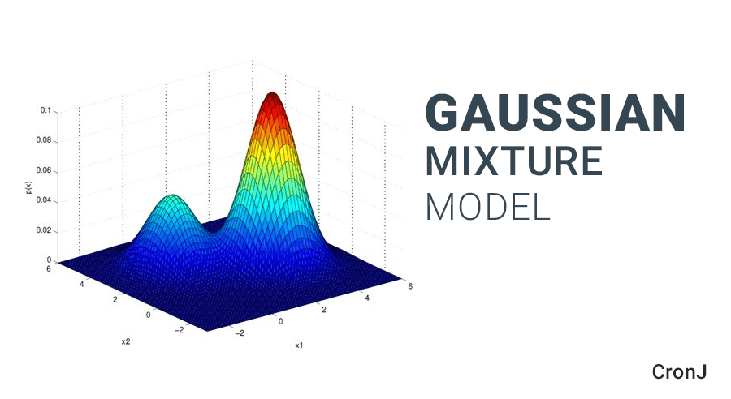
What is Gaussian Mixture Model?
Is a statistical tool that helps in modelling the properties of different subjects
In our context, GMMs serves as a framework to accommodate the variability in human speech
The performance of this model depends on the quality and quantity of training data and the number of mixture components chosen
Sample GMM output from Google Images
Notes:
[Abhay]
We will start by diving into an import concept in biometrics the Gaussian Mixture Model, this isn’t just another statistical method in our project instead it will help us understand the complex patterns in our speech. For example you are in a crowded room having a conversation our brain will pick up different speakers, this is similar to GMM but more math oriented, it looks at speech as multiple elements, thus we are using this to make our project reliable.

Slide 4

What is Speech Recognition?
Is a technology that allows computers and other devices to interpret and process human speech. Can be seen in virtual assistants(Siri/Alexa) and automated customer service systems
Is comprised of several components such as: audio collection, feature extraction, and pattern recognition
Challenges which are faced is understanding diverse accents, dialects and languages and as well noisy backgrounds
Speech Recognition Clipart from Google Images
Notes:
[Abhay]
World of speech recognition is all around us, think about the last time you asked Siri or Alexa for weather or directions, that’s speech recognition converting your voice into actionable commands. The complex components this is built on is capturing audio, then isolate distinct features within that audio, similar to our lab fingerprint makes each word unique. This a continuous adapting as the complexities of human speech is tough to nail down.

Slide 5
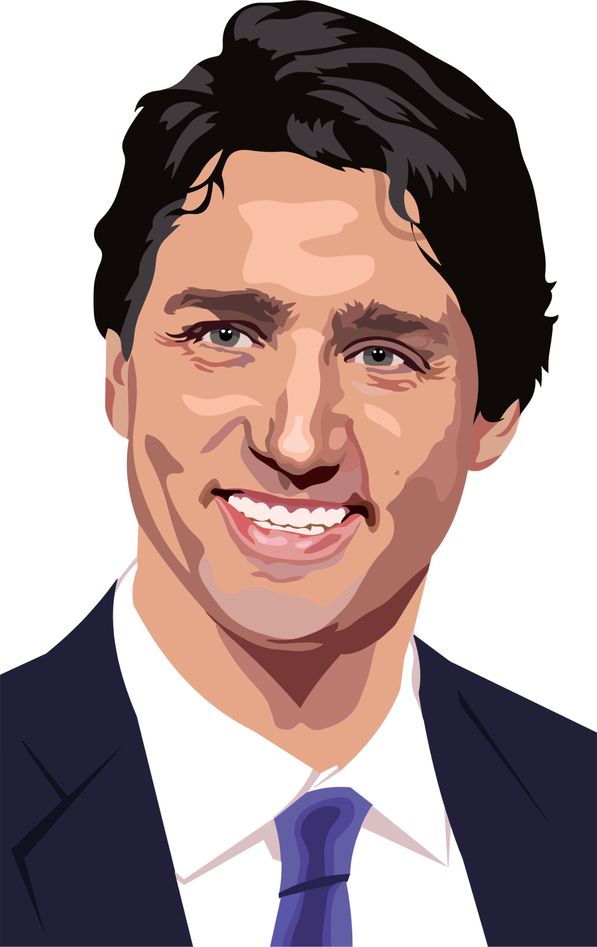
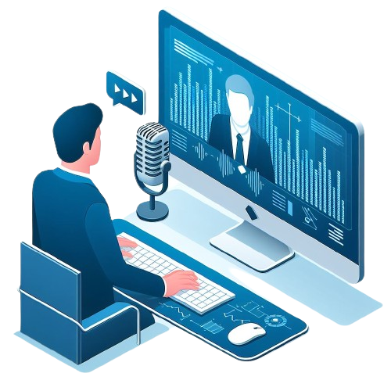

Project Overview
Subject 1: Justin Trudeau
AI or Real Speech
Probe Dataset: AI generated speeches in both subjects voice
Justin Trudeau clipart from Google Images
AI or Real Speech
AI Voice Clone clipart from Google Images
Subject 2: Donald Trump
Donald Trump clipart from Google Images
Notes:
[Abhay]
The focus in this project is between AI-generated speech and authentic dataset of speech, which for us will be two famous politicians Justin Trudeau and Donald Trump. Through our probe data set we have generated AI speeches of the subjects to understand our model’s accuracy in distinguishing between AI and real speech.

Slide 6
Project Process Phases
Performing Feature Extraction (MFCC)
Performing Classification & Calculating Scores
Acquisition of Data
2
4
6
1
3
5
Reading & Processing Data
Training the GMM Using Training Data
Performing Validation With Probe Samples (AI)
Notes:
[Mush]

Slide 7
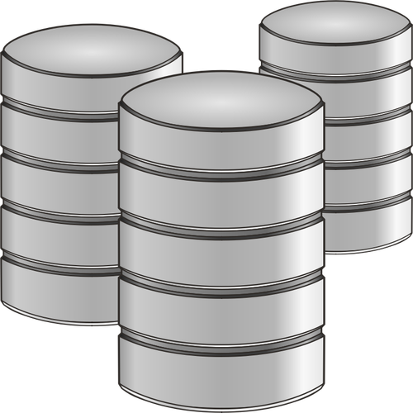
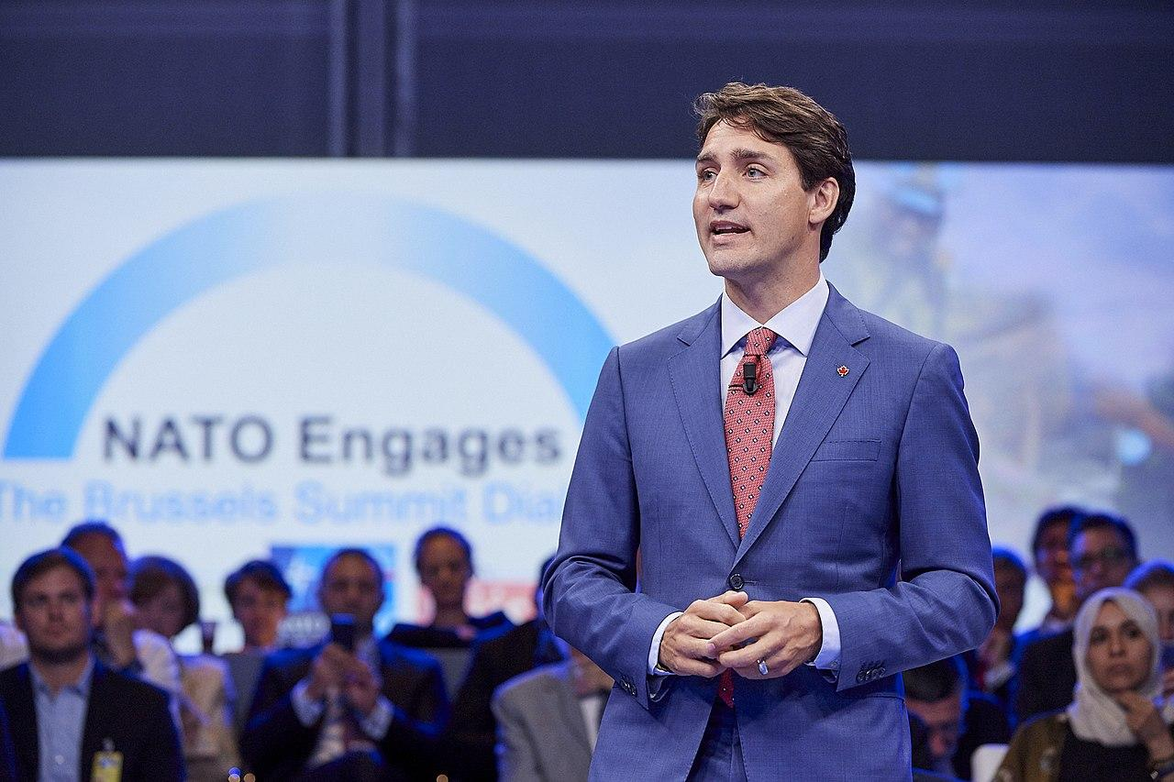
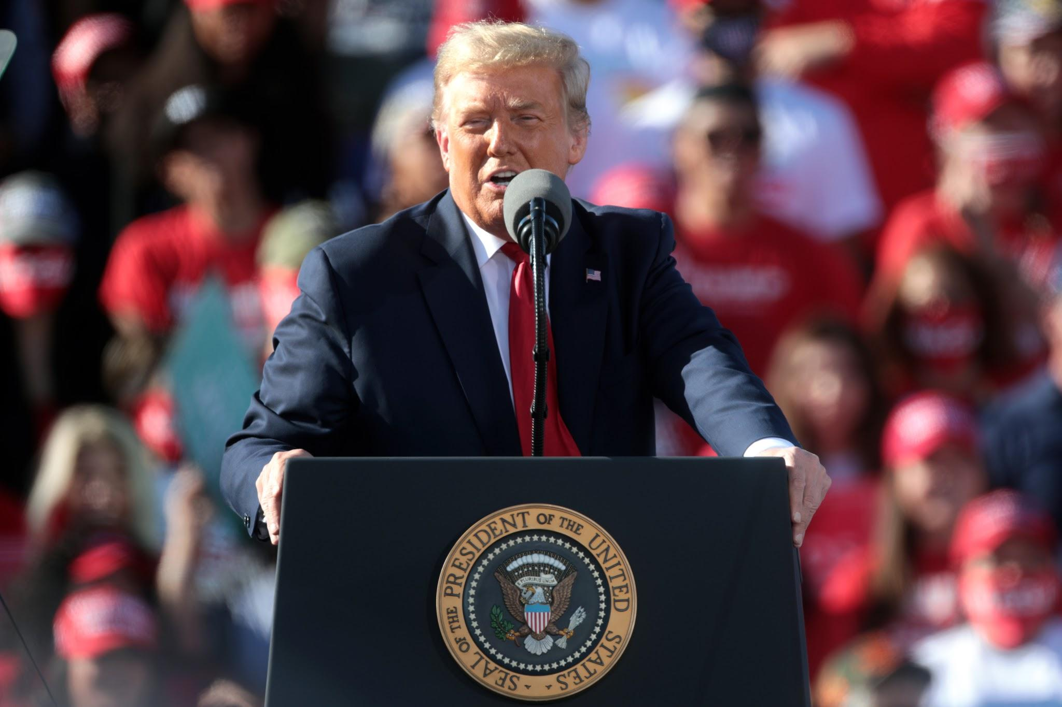
Acquisition of Data
In total, 20 genuine speeches and 20 “AI” generated speeches
Followed the 80/20 rule, training on 80% of the data & testing on remaining 20%
Speeches converted into .wav format from MP4
Ensured all data was sampled at 48kHz for consistency
10 Genuine Speeches
10 AI Speeches
10 Genuine Speeches
10 AI Speeches
Database, Trudeau, and Trump from Google Images

Slide 8
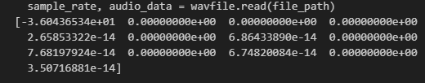
Reading and Processing Data
The speeches were read using SciPy’s ‘wavfile’ method
The method returns both the sample rate and wave data of the audio file
Wave data represents the audio waveform
Once again, the sample rate of our data files were all 48kHz

Slide 9
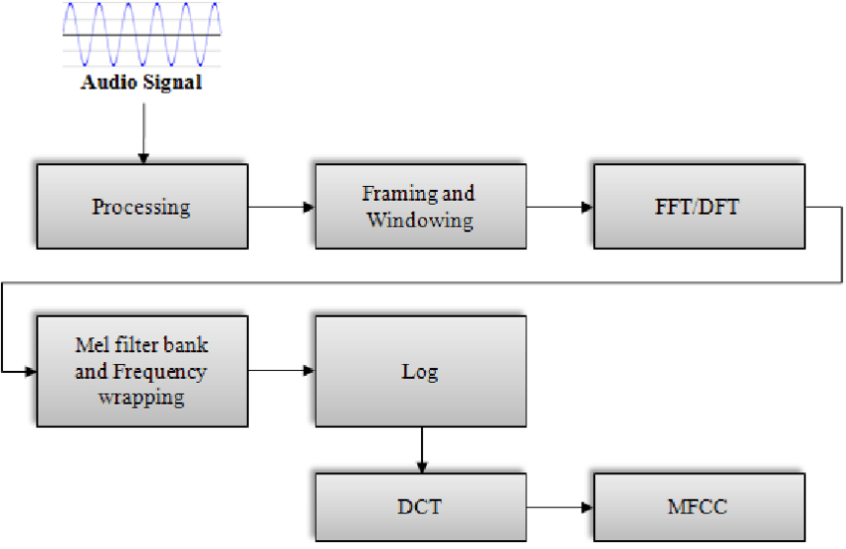

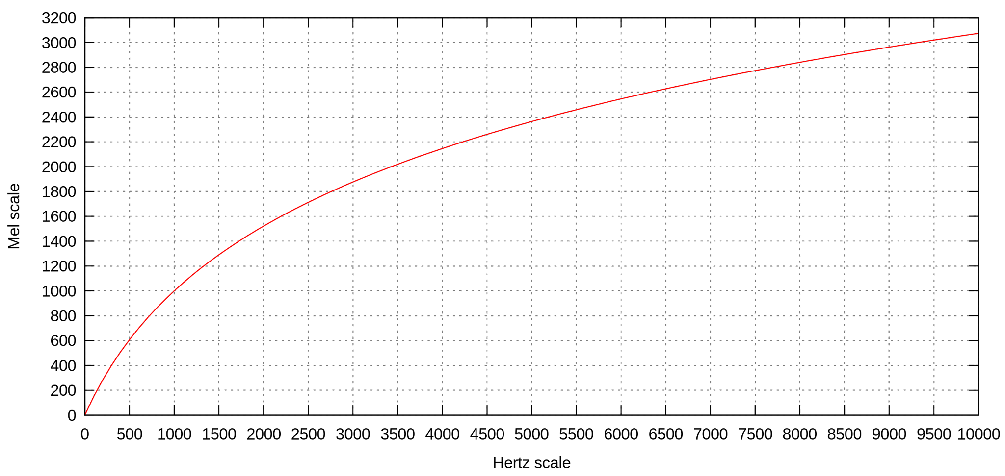
Feature Extraction (MFCC)
Mel-frequency cepstral coefficients make up an MFC, commonly used in speech recognition
In MFC, the frequency bands are equally spaced on the mel scale
The python_speech_features library was used to perform MFCC on our data
As a result, MFCCs (amplitudes of resulting spectrum) stored in numpy array
https://www.researchgate.net/figure/Flowchart-of-MFCC-extraction-procedure_fig3_257135369
Notes:
[Mushtaba]
MFCC is commonly used in speech recognition and used to model the human characteristics of voices. Mel-frequency cepstral coefficients that make up an MFC, where the frequency bands are equally spaced on the mel scale which approximates the human auditory system more closely compared to linearly spaced bands. To calculate MFCCs, the discrete fourier transform of the signal is taken, then a logarithm, which is then taken a fourier inverse of, which is essentially a spectrum of a spectrum, giving the name cepstrum. As a result, the MFCCs are the amplitudes of the cepstrum, which is stored in a numpy array.
Notes: Human ears don't perceive changes in pitch (frequency) linearly. That means a change of 100 Hz might be barely noticeable in some ranges, while in other ranges, it could sound like a huge difference. When we map frequencies to the Mel scale, lower frequencies are more spread out, while higher frequencies are more compressed. This reflects how our ears are more sensitive to changes in pitch at lower frequencies compared to higher ones.

Slide 10


Training the GMM
GMM is the weighted sum of Gaussian PDFs
GMM trained using our training data, (currently 8 files), representing 80% of the genuine data
Notes:
[Mushtaba]
GMM is a weighted sum of Gaussian probability density functions known as Gaussian components. Just like in our previous labs, we trained the GMM using our training data which represented 80% of our genuine input data.

Slide 11
Classification and Log-Likelihood Scores
In the classification stage of speaker recognition, the extracted features are input into a trained Gaussian Mixture Model (GMM).
The GMM calculates the log-likelihood score for each speaker model based on how well the input features match the model.
Log-likelihood scores are crucial as they indicate the likelihood of the input features belonging to a particular speaker model.
Notes:
[Parbir]
In the classification stage the extracted features are input into a trained Gaussian Mixture Model (GMM). The GMM represents the acoustic characteristics of each speaker based on the training data.
The GMM calculates the log-likelihood score for each speaker model based on how well the input features match the model. The speaker with the highest log-likelihood score is then identified as the speaker.
This scoring process enables accurate speaker identification in speaker recognition systems.

Slide 12
Results
Donald Trump Real Testing GMM Scores
[-47.25106881699593, -47.35176302124236, -47.514431289022, -47.07971270835171, -47.20429360697252, -47.1180495648579, -47.3056006279181, -47.674193970906266, -47.28388922712286, -47.193320797496895, -47.25106881699593, -47.35176302124236, -47.514431289022, -47.07971270835171, -47.20429360697252, -47.1180495648579, -47.3056006279181, -47.674193970906266, -47.28388922712286, -47.193320797496895]
Donald Trump AI GMM Scores
Notes:
[Parbir]
Here we can see a comparison of the log- likelihood scores of Ai and genuine speaker audios. We can see that the AI data has a lower log likelihood score indicating that the audio sample differs from the speaker model.

Slide 13
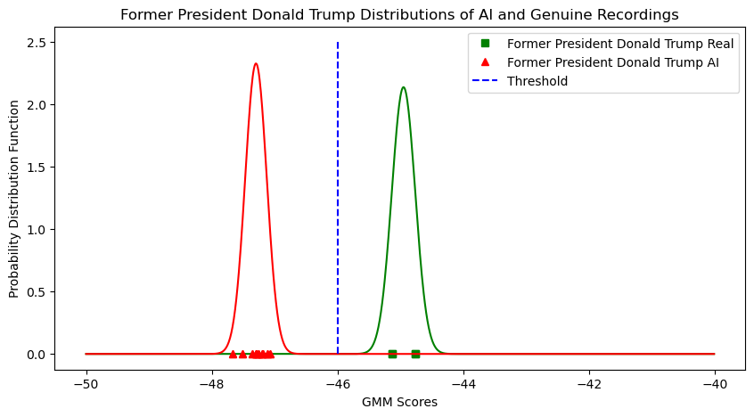
Results
Notes:
[Parbir]
And here we can see our distributions where the GMM score for the real data is higher than the AI data.

Slide 14
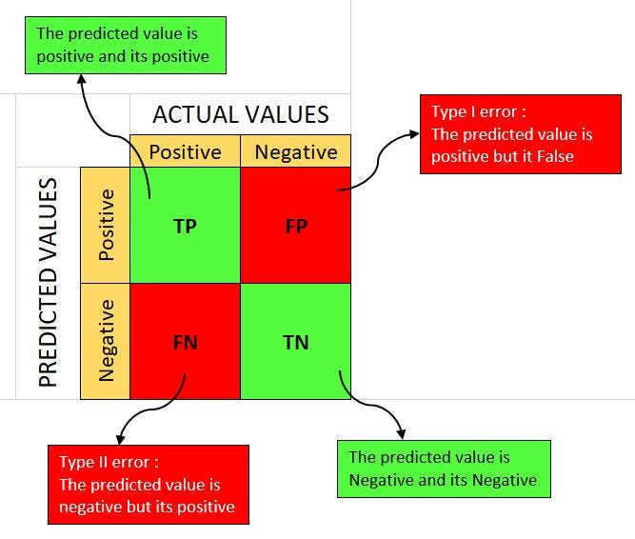
Next Steps
Integrate confusion matrices for both subjects to evaluate the performance of our speech recognition models
Calculate the true positives, false positives, true negatives and false negatives enhancing our understanding of the model’s accuracy
Perform a detailed analysis of the probability density function plots to identify the areas for improvement in the model
Confusion Matrix clipart from Google Images
Notes:
[Abhay]
As we are progressing towards completion of the project, for now we have generated Probability Density Function plots, in our coming steps we will do it for Justin Trudeau and also include a confusion matrix for both.

Slide 15
Conclusion
Today we showed just one of many possible ways in which voice voice biometrics can be used
As machine learning improves over time, speech recognition can be used to solve many ethical issues in society (misinformation/disinformation)
However, voice biometrics and speech recognition can also be used in a variety of ways:
Accessibility tools
Voice assistants (Siri, Google Assistant, etc
Education
Quality of Life (IoT and smart devices)
Notes:
[Mush]

Slide 16


Notes:
[Mush]

